Slide 1
OLYMPIA GYMNASTICS BOOSTER CLUB (OGBC)
2020-2021 ANNUAL MEMBERSHIP PRESENTATION

Slide 2
AGENDA
OGBC (Quick Overview)
The OGBC Difference
Athlete Warrior Challenge
The Power of Membership
Communication/OGBC Portal

Slide 3
WHO ARE WE?
501©3 – Non-profit organization
Established to support Olympia Gymnastics Academy athletes as they compete in competitive, amateur gymnastics

Slide 4
OGBC BOARD
Vince Gigliotti, President
Mary Shelton, Vice president
Open Position, Secretary
Mike Ratusznik, Treasurer
Open Position, Assistant Treasurer
Dave Cafagna, Communications
Open Position, Social Coordinator
Open Position, Trustee
Open Position, Trustee
Open Positions, Trustee
*Open positions are a result of members vacating positions and Covid conditions that did not require fundraising coordination. Positions will be filled at next general election in July 2021.

Slide 5
OGBC PURPOSE TO PROMOTE AND HELP SUPPORT COMPETITIVE AMATEUR GYMNASTICS
Generate funds
Pay costs associated with competitive gymnastics
Host and sponsor meets
Meets = Fundraisers

Slide 6
DID YOU KNOW?
ON AVERAGE - IT COST $1,003 PER GYMNAST FOR ENTRY FEES OVER THE COURSE OF THE SEASON

Slide 7
MEMBER BENEFITS
Every attempt is made to keep expenses to a minimum, while at the same time creating a safe and competitive environment for our gymnasts to grow and be successful.
OGBC has not increased dues in over 14 years.
HOW IS THAT POSSIBLE?

Slide 8
ATHLETE WARRIOR CHALLENGE
OUR MAJOR FUNDRAISER!
Thursday, January 27th – Sunday, January 30th 2022
Thursday is set- up and Sunday evening is tear down
3 or 4 gyms and dedicated awards area
3 to 4 work sessions per family – Everyone helps!
Additional Meet – Boys or Girls we all work an equal amount to raise funds for OGBC!

Slide 9
ATHLETE WARRIOR CHALLENGE SPONSORS (AWC INFO FROM JAN. 2020)
BRAND EXPOSURE FOR OUR SPONSORS:
We had almost 3,000 gymnasts from Ohio, Michigan (Livonia, Port Huron, Farmington, Troy, Rochester, Shelby Township, Lansing and more) and Canada.
AWC Website
4600 people visited the website in the last 30 days after the event.
60% of those people were new visitors. 40% were returning.
Visitors were spread out from the Detroit, Grand Rapids Ann Arbor and Saginaw areas
Facebook Page
729 Total Followers
56 New Followers
1654 Page Views

Slide 10
OGBC 2019-2020 FINANCIAL INFORMATION
Our current balance in the treasury of $26,791.81.
Due to the pandemic we were unable to host AWC this year. AWC is our biggest (and only) fundraiser each year. Based on the projections of OGA (with fewer meets this year) the board has determined that dues need to be collected in order to support all gymnasts competing. *Dues will only be collected from those members choosing to compete.
As a reminder, we encourage you to sign up at Amazon and Kroger which helps provide funds to OGBC with no cost to you. This provided almost $2,000 of additional funds last year.

Slide 11
2020-2021 Team Dues
All Levels – Payment Schedule ($460)
$230 due March 1st, 2021
$230 due April 1st, 2021
Level Excel Silver– Payment Schedule ($360)
$180 due March 1st, 2021
$180 due April 1st, 2021
*Dues have been adjusted to cover the costs for the 2021 Meet Season outlined by Olympia Gymnastics Academy for athletes competing. *Payments can be made via PAYPAL. OGBC will accept full payments of $460 and $360 or two separate payments outlined above.
If you have any additional questions, please feel free to contact me at the below email address. mikeratusznik@olympiabooster.com
PLEASE PUT YOUR GYMNAST’S FIRST AND LAST NAME ON ALL COMMUNICATIONS TO OGBC, THANKS!

Slide 12
HOW DO OGBC DUES COMPARE?
WHAT DOES OLYMPIA DO TO KEEP DUES DOWN? OLYMPIA KEEPS AND USES PROFITS FROM AWC TO SUPPORT ALL GYMNASTS/MEMBERS OLYMPIA PLANS MEETS AND MEET FEE BUDGETS WELL IN ADVANCE | WHAT DO WE DO TO KEEP DUES DOWN? ATHLETE WARRIOR IS MAIN FUNDRAISER WE NEED YOUR SUPPORT IN THE FORM OF TIME EXPENSES ARE KEPT MINIMUM AND MONITORED MONTHLY

Slide 13
WHAT ELSE DO WE USE THE $$$ FOR?
Gymnastics team entry fees for EACH LEVEL, PER MEET;
Gymnastics meet entry fees for each gymnast;
Gymnastics clinic/camp entry fees for each gymnast;
Jr Team-Level 2 required gymnastics apparel;
OGA coaches travel costs for meets, clinics, and camps;
OGA coaches meal expenses while supporting meets, clinics, and camps;
Gymnasts travel expenses for those athletes who make it to Nationals;
Upfront costs of planning and arranging for AWC, other meets, and camps;
Social functions for the team including the end of the year banquet;
Education seminars for coaches (to help improve training techniques for our gymnasts skills);
Administrative costs of managing OBGC itself (very minimal);
Any other expense that the Board feels is in line with our mission and is supportive of our gymnasts’ goals and aspirations.

Slide 15
OGBC COMMUNICATIONS
Primary communication through email
Emails are based on OGBC portal
Returning members, review and update profile
New members, create a profile
Other Methods of Communication:
OGBC Website
Facebook OGBC Page
Mailbox
In Person
Agreements:
Letter of Acknowledgement
Photo Consent
Accepted through the OGBC Portal and available on OGBC website

Slide 16
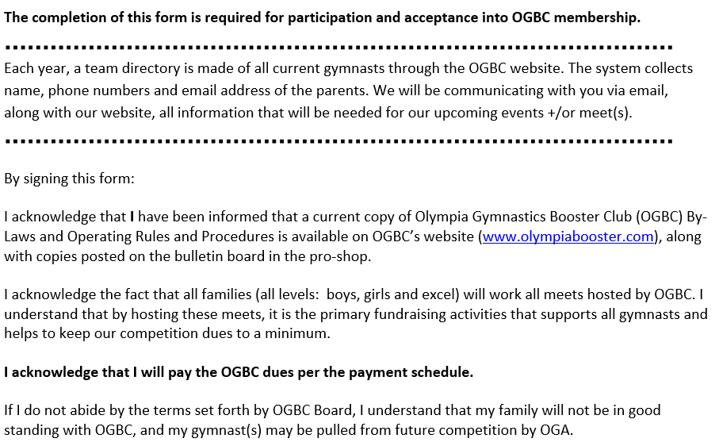
OGBC COMMUNICATIONS
Letter of Acknowledgement

Slide 17
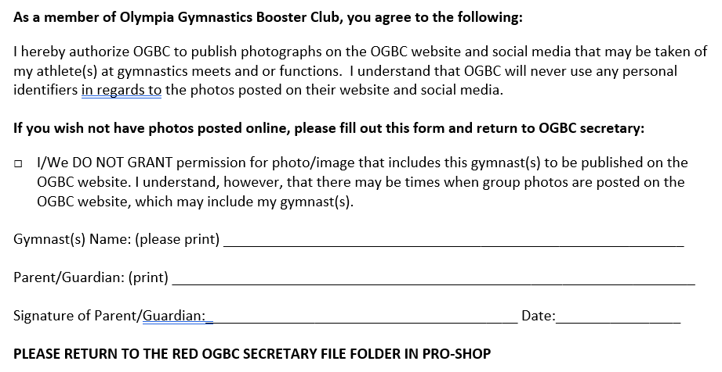
OGBC COMMUNICATIONS
Photo Consent

Slide 18
OGBC PORTAL SIGN UP
One sign-up per family
Name
Primary and Alternate Email Addresses
Address
Phone Number(s)
Gymnast(s) Info

Slide 19
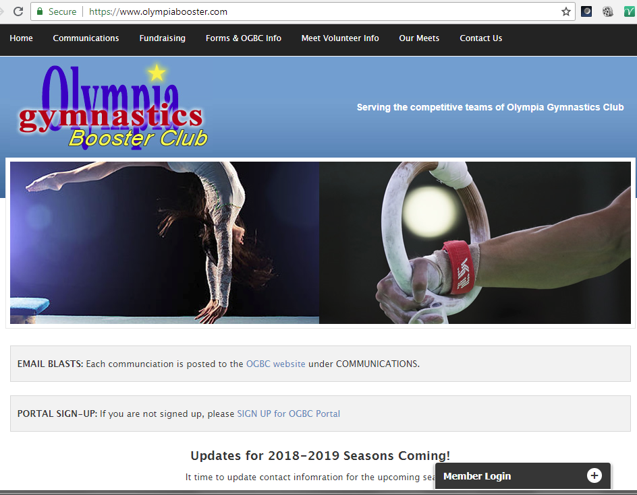
REVIEW OGBC PORTAL CONTACT INFO STEP 1: LOG INTO PORTAL
Go to www.olympiabooster.com
Click the + sign next to Member Login
Enter your email and password
Click Log In button

Slide 20
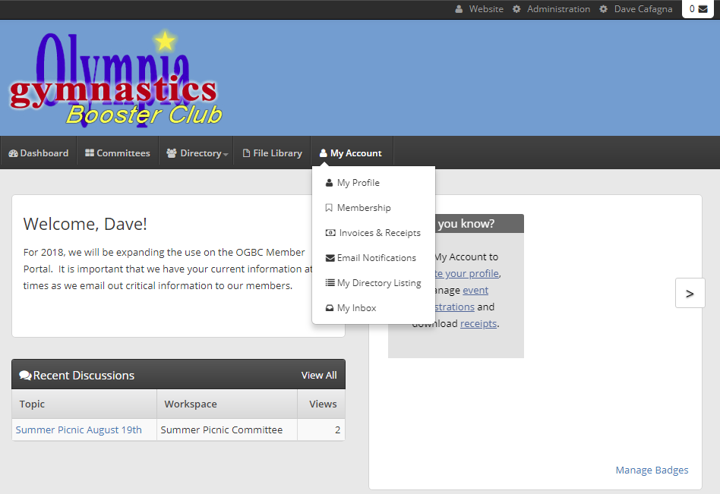
REVIEW OGBC PORTAL CONTACT INFO STEP 2: GO TO MY PROFILE
Click My Account and My Profile

Slide 21
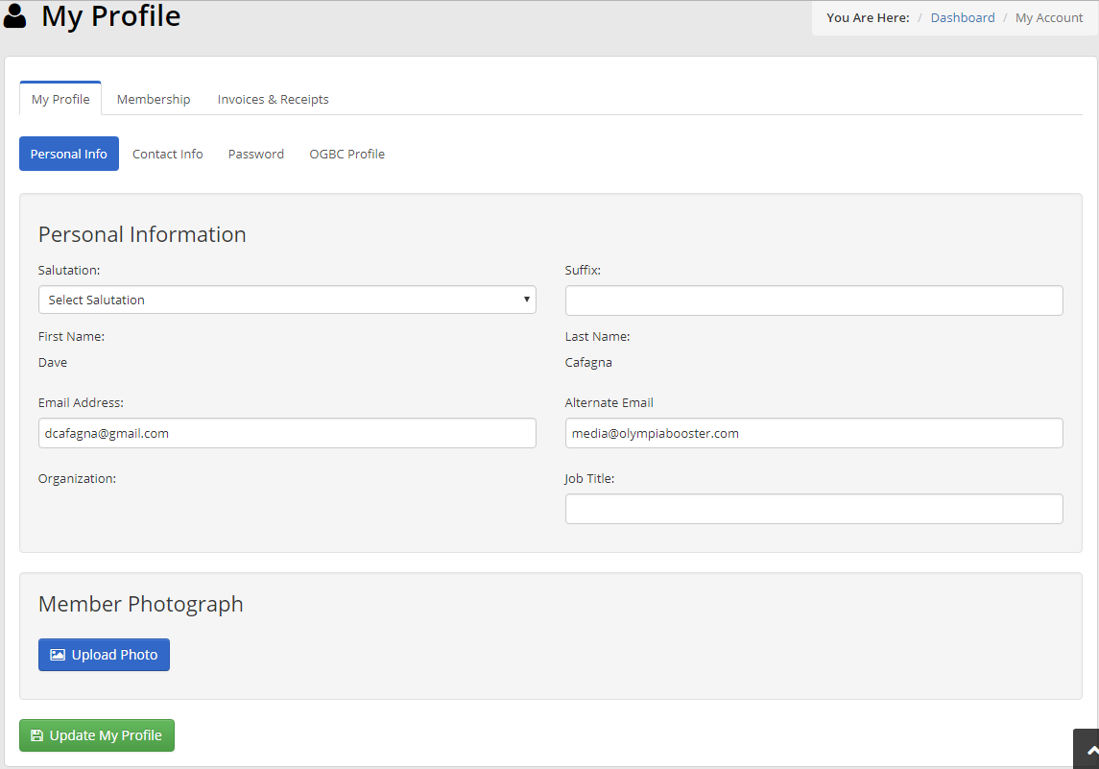
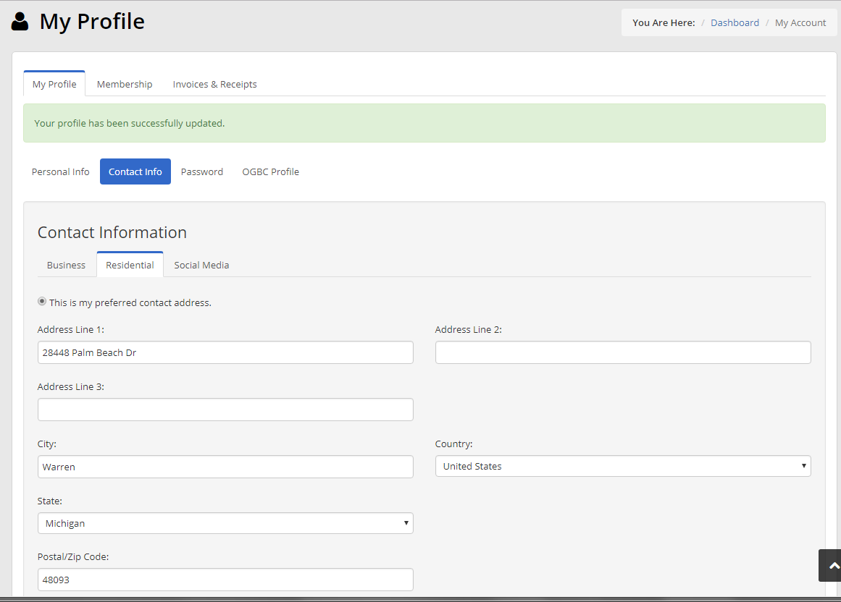
REVIEW OGBC PORTAL CONTACT INFO STEP 3: UPDATE INFORMATION
Update Personal Info tab
Update Contact Info tab

Slide 22
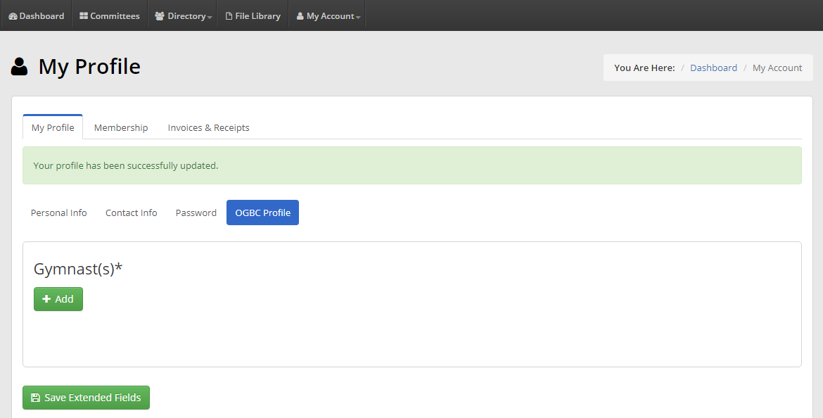
REVIEW OGBC PORTAL CONTACT INFO STEP 4: UPDATE GYMNAST
Update gymnast(s) under OGBC Profile

Slide 23
MEMBERSHIP ZOOM
If you have questions regarding membership or anything in this presentation please plan on attending an optional membership zoom meeting on SUNDAY, MARCH 7, at 5:00 pm.
ZOOM INFORMATION
Topic: OGBC MEMBER MEETING
Time: Mar 7, 2021 05:00 PM Eastern Time (US and Canada)
https://us02web.zoom.us/j/84970468952
Meeting ID: 849 7046 8952

